Slide 1
Causal manipulation of early noise biases numerosity judgements towards adaptive prior means
*slides
Brenden Eum
Antonio Rangel
Michael Woodford
RNL Lab Meeting - SDN Proseminar

Slide 2
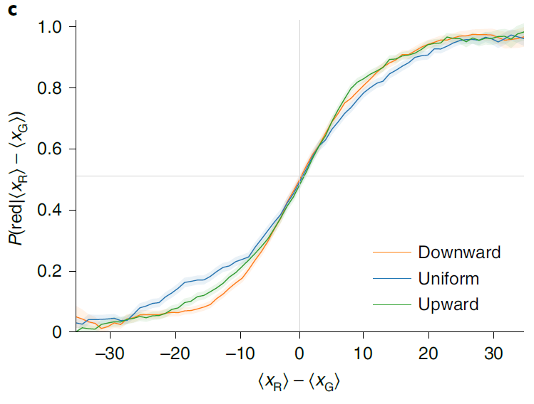
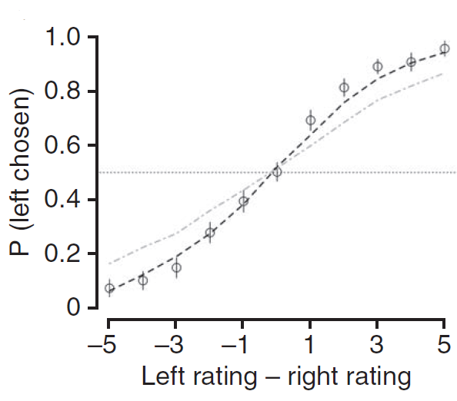
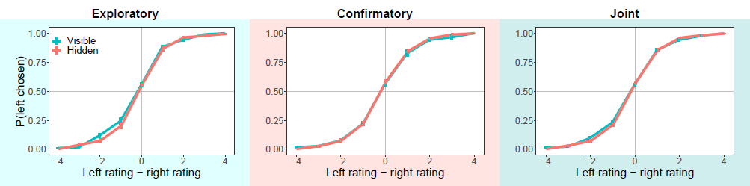
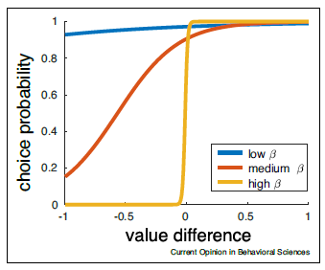
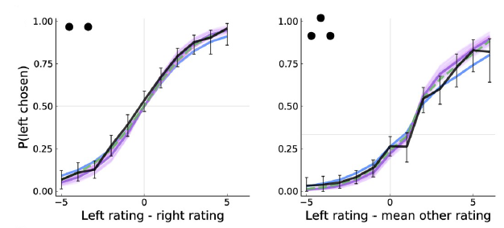
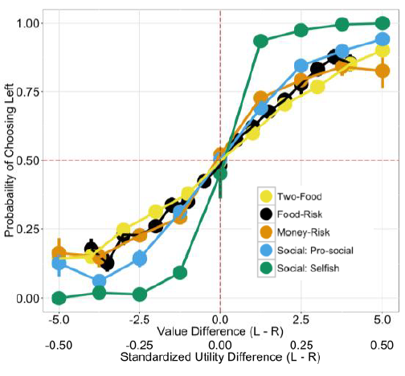
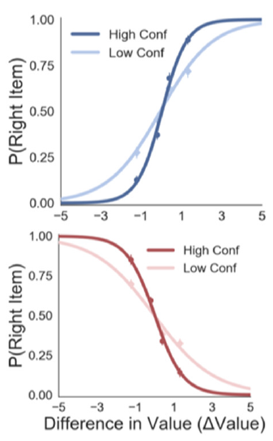
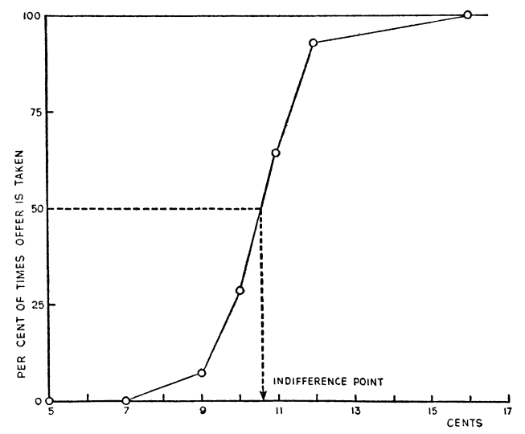
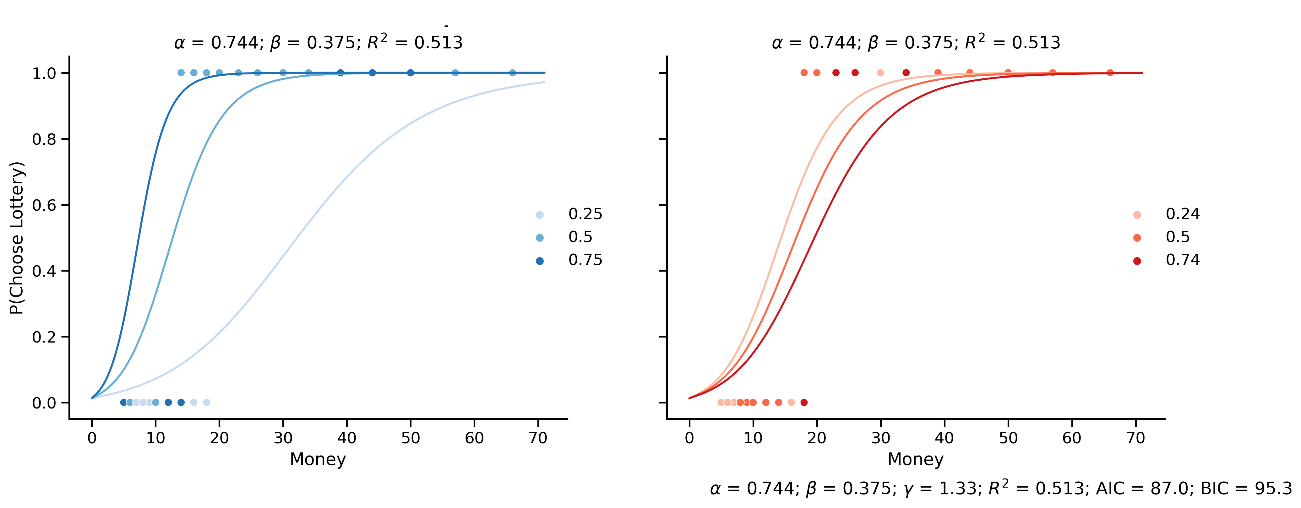
Choices exhibit randomness
Eum, Dolbier, and Rangel (2023)
Krajbich, Armel, and Rangel (2010)
Bhui, Lai, and Gershman (2021)
Prat-Carrabin and Woodford (2022)
Callaway, Rangel, and Griffiths (2021)
Smith and Krajbich (2019)
Deshawn Sambrano
Mostellar and Nogee (1951)
Sepulveda et al. (2020)
Notes:
Mostellar and Nogee:

Slide 3
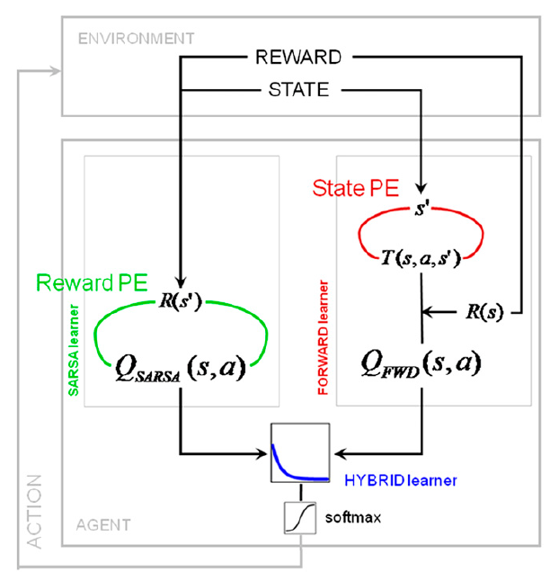
Modeling randomness: Softmax
Glascher, Daw, Dayan, and O’Doherty (2010)

Slide 4
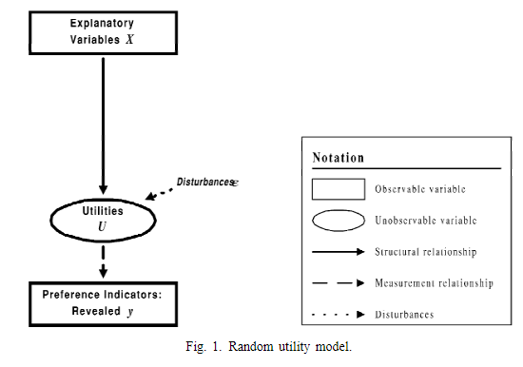
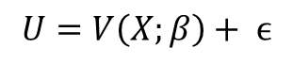
Modeling randomness: Random utility models
$$U=V\left(X;β\right)+ ϵ$$
Walker and Ben-Akiva (2002)

Slide 5
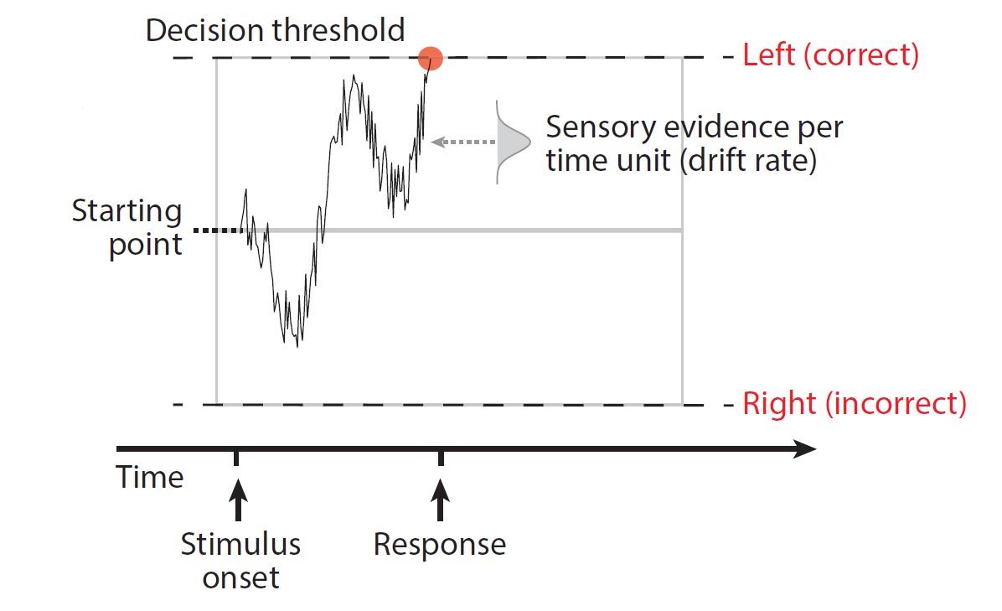
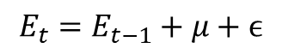
Modeling randomness: Drift-Diffusion-Model
$$E_{t}=E_{t−1}+μ+ϵ$$
Forstmann, Ratcliff, and Wagenmakers (2016)

Slide 6
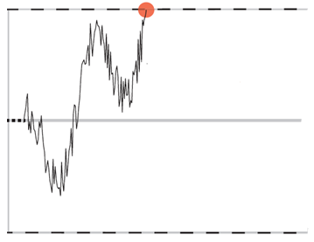
“Late” noise
Noise is added at the time of decision making.

Slide 7
+
Guess how many blue dots there are on each of the following screens.

Slide 8


Slide 10
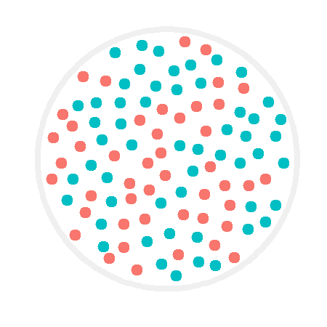

Slide 12


Slide 14
54

Slide 15
Is noise entering into the decision-making process solely at the late stage? Where else might it be entering at?

Slide 16
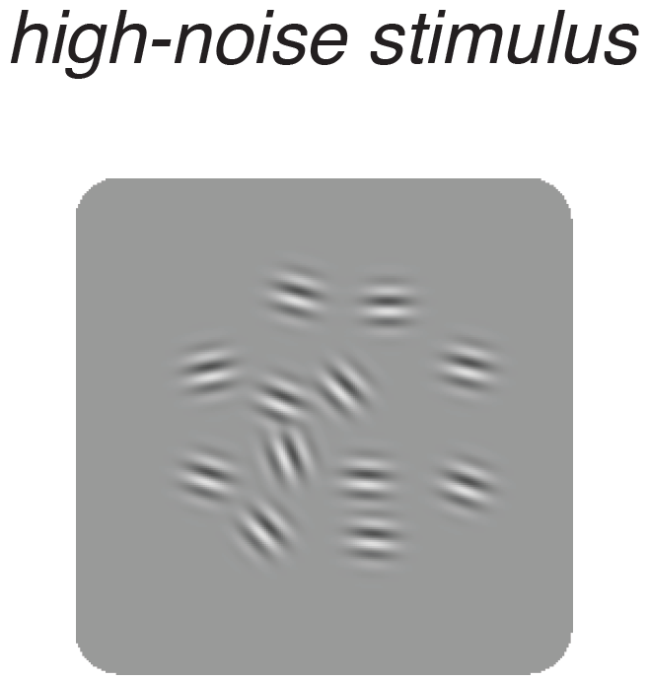
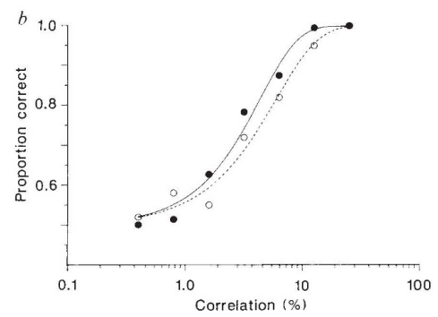
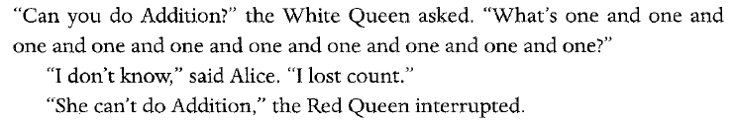
“Early” noise
Noise is added at the time of stimulus encoding.
Wei and Stocker (2012)
Newsome, Britten, and Movshon (1989)
Quote from Through the Looking Glass by Lewis Carroll
Example from The Number Sense: How the Mind Creates Mathematics
by Stanislas Dehaene

Slide 17
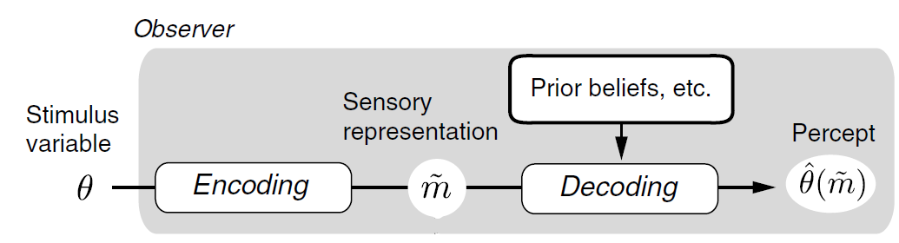
Encoding-decoding models
Wei and Stocker (2017)

Slide 18
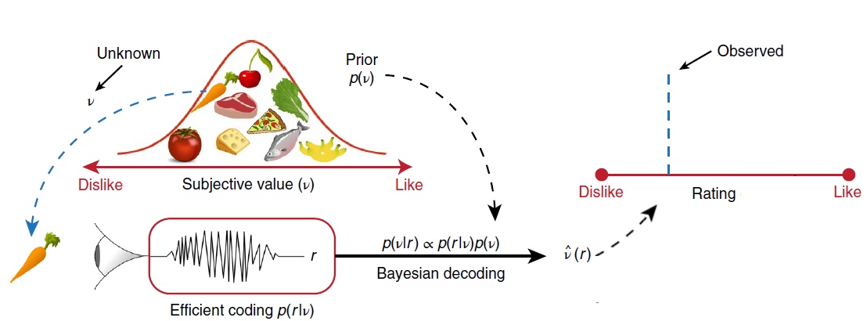
Encoding-decoding models
Polania, Woodford, and Ruff (2019), with edits

Slide 19
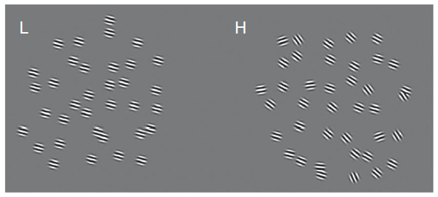
Model Class 1: Stable naturalistic priors
In perception: Olshausen and Field (1996); Simoncelli and Olshausen (2001); Olshausen and Field (2004); Geisler (2011); Girshick, Landy, and Simoncelli (2011)
In numerosity perception: Dehaene (1997); Cheyette and Piantadosi (2020)

Slide 20
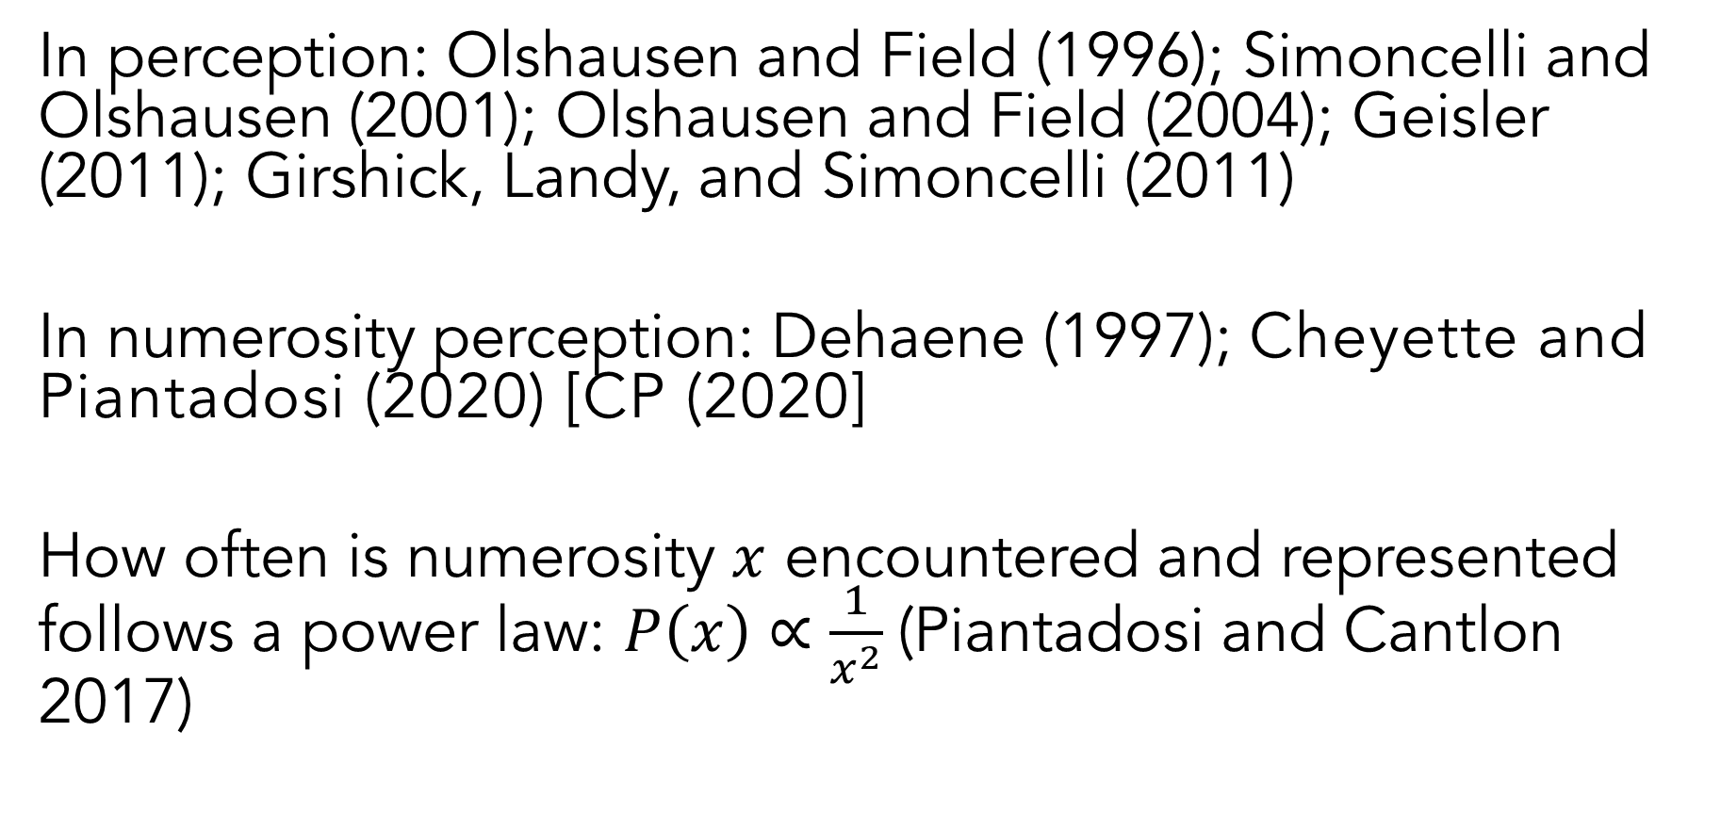
Model Class 1: Stable naturalistic priors
In perception: Olshausen and Field (1996); Simoncelli and Olshausen (2001); Olshausen and Field (2004); Geisler (2011); Girshick, Landy, and Simoncelli (2011)
In numerosity perception: Dehaene (1997); Cheyette and Piantadosi (2020) [CP (2020]
How often is numerosity $x$ encountered and represented follows a power law: $P\left(x\right)∝\frac{1}{x^{2}}$(Piantadosi and Cantlon 2017)

Slide 21
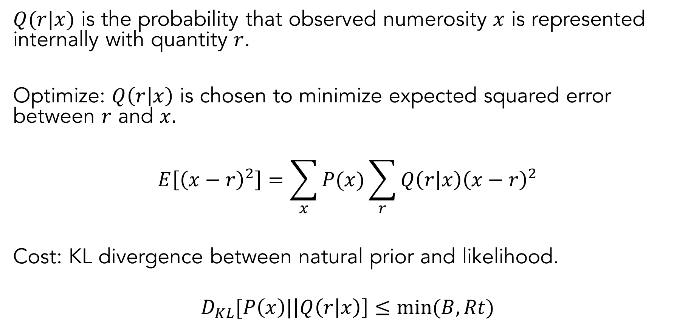
CP (2020): Efficient encoding
$Q(r|x)$ is the probability that observed numerosity $x$ is represented internally with quantity $r$.
Optimize: $Q\left(r | x\right)$ is chosen to minimize expected squared error between $r$ and $x.$
$$E\left[{\left(x−r\right)}^{2}\right]=\sum_{x}{P(x)}\sum_{r}{Q\left(r | x\right){\left(x−r\right)}^{2}}$$
Cost: KL divergence between natural prior and likelihood.
$$D_{KL}[P\left(x\right)|\left|Q\left(r | x\right)\right]≤min⁡(B, Rt)$$

Slide 22
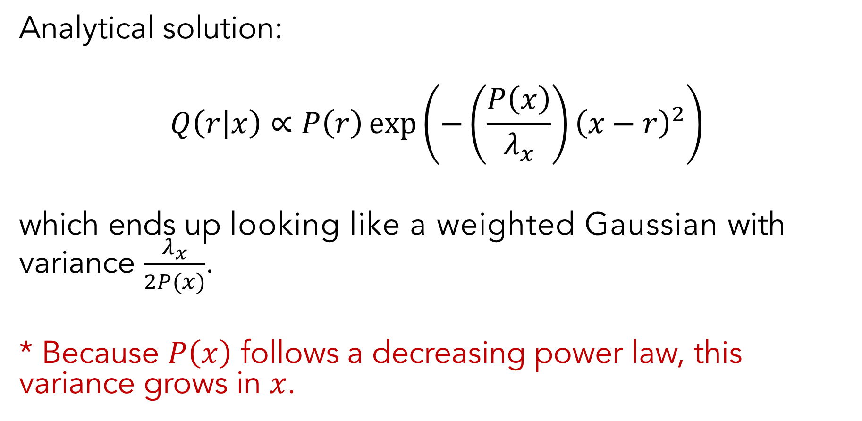
CP (2020): Decoding
Analytical solution:
$$Q\left(r | x\right)∝P\left(r\right)\exp\left(−\left(\frac{P\left(x\right)}{λ_{x}}\right){\left(x−r\right)}^{2}\right)$$
which ends up looking like a weighted Gaussian with variance $\frac{λ_{x}}{2P(x)}$.
* Because $P\left(x\right)$ follows a decreasing power law, this variance grows in $x$.

Slide 23
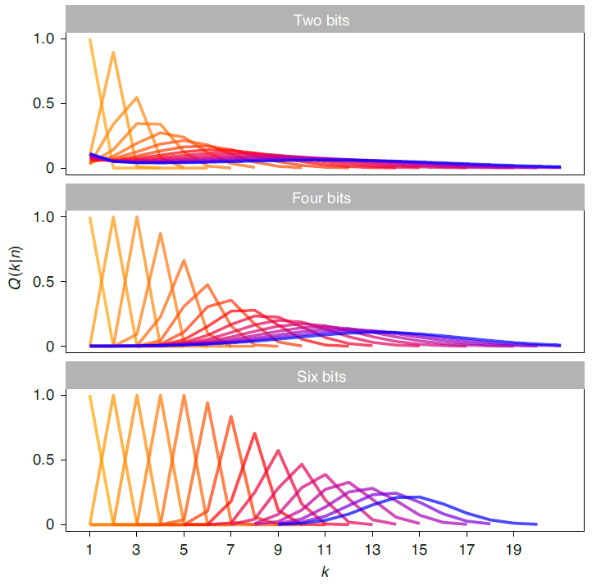
CP (2020)

Slide 24
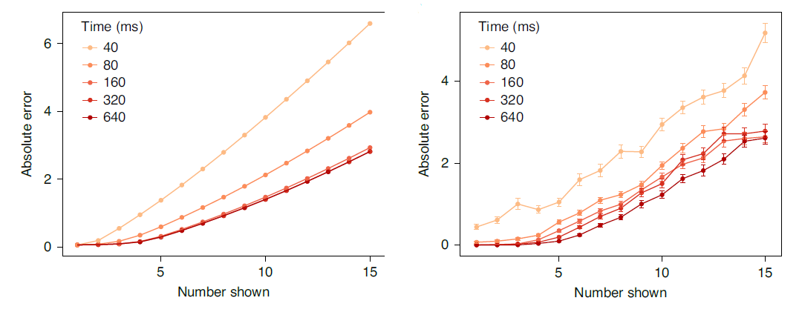
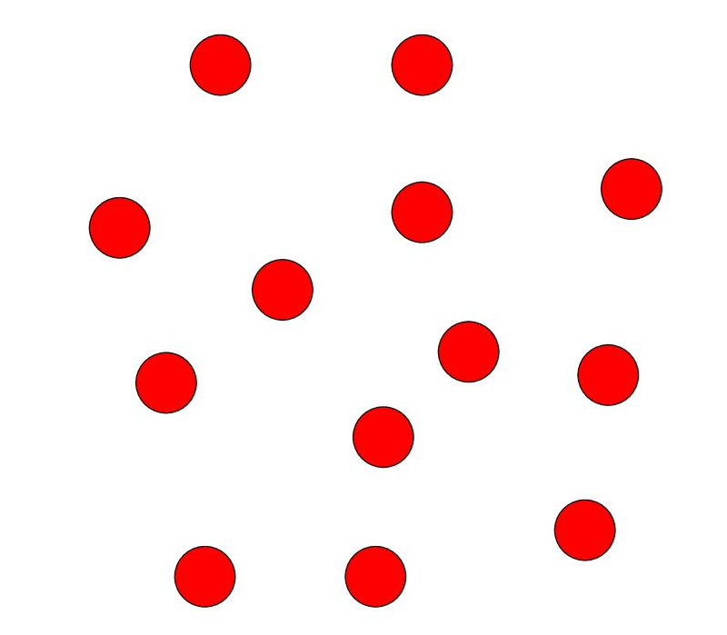
CP (2020)

Slide 25
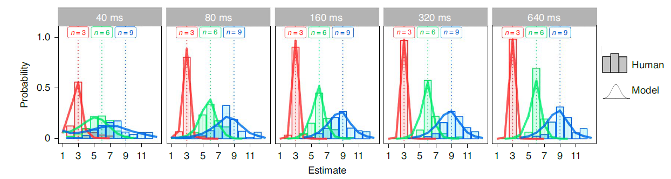
CP (2020)

Slide 26
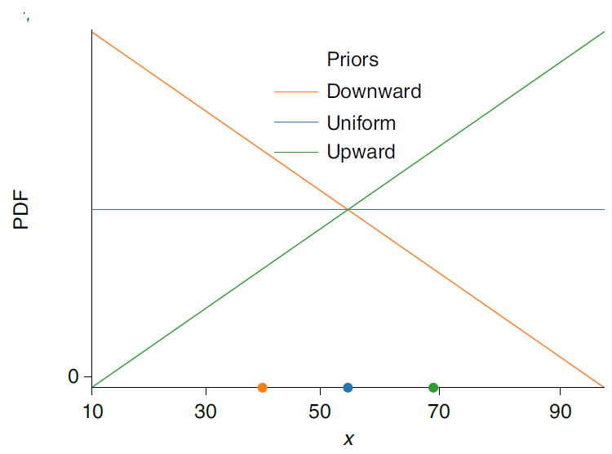
Model Class 2: Efficient coding, Bayesian decoding (ECBD)
Why can’t the prior adapt to different contexts?
[Prat-Carrabin et al. (2021), Prat-Carrabin and Woodford (2022)]

Slide 27
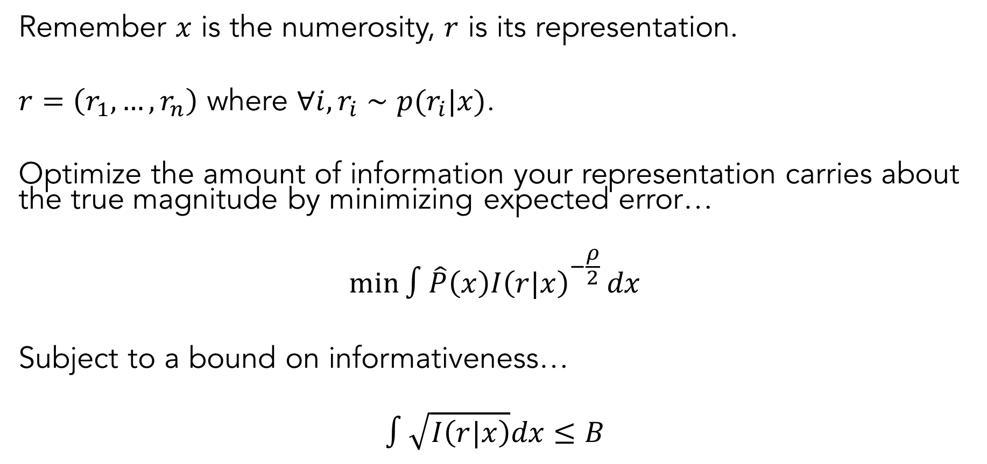
ECBD: Efficient coding
Remember $x$ is the numerosity, $r$ is its representation.
$r=\left(r_{1},…,r_{n}\right)$ where $∀i, r_{i}∼p(r_{i}|x)$.
Optimize the amount of information your representation carries about the true magnitude by minimizing expected error…
$${\min{∫\hat{P}\left(x\right)I\left(r|x\right)}}^{−\frac{ρ}{2}}dx$$
Subject to a bound on informativeness…
$$∫\sqrt{I\left(r|x\right)}dx≤B$$

Slide 28
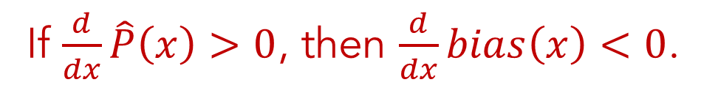
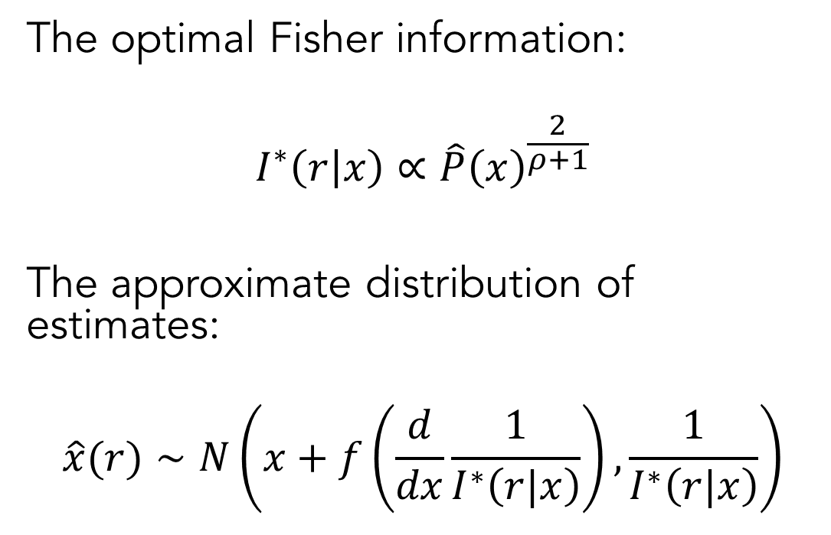

ECBD: Bayesian decoding
The optimal Fisher information:
$$I^{∗}\left(r | x\right)∝\hat{P}{\left(x\right)}^{\frac{2}{ρ+1}}$$
The approximate distribution of estimates:
$$\hat{x}(r)∼N\left(x+f\left(\frac{d}{dx}\frac{1}{I^{∗}\left(r|x\right)}\right),\frac{1}{I^{∗}\left(r|x\right)}\right)$$
If $\frac{d}{dx}\hat{P}\left(x\right)>0$, then $\frac{d}{dx}bias\left(x\right)<0$.
If $\frac{d}{dx}\hat{P}\left(x\right)<0$, then $\frac{d}{dx}bias\left(x\right)>0$.
bias
noise

Slide 29
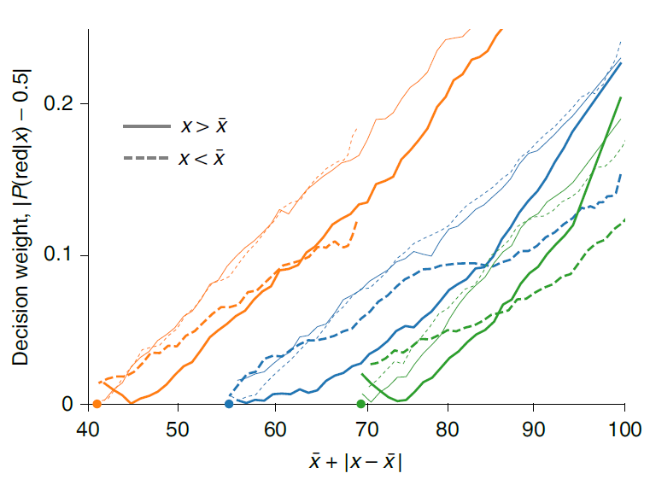
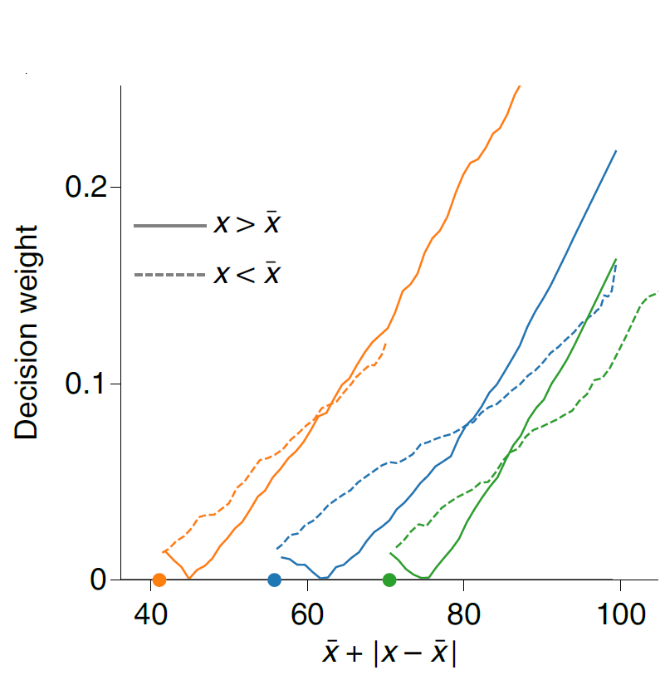

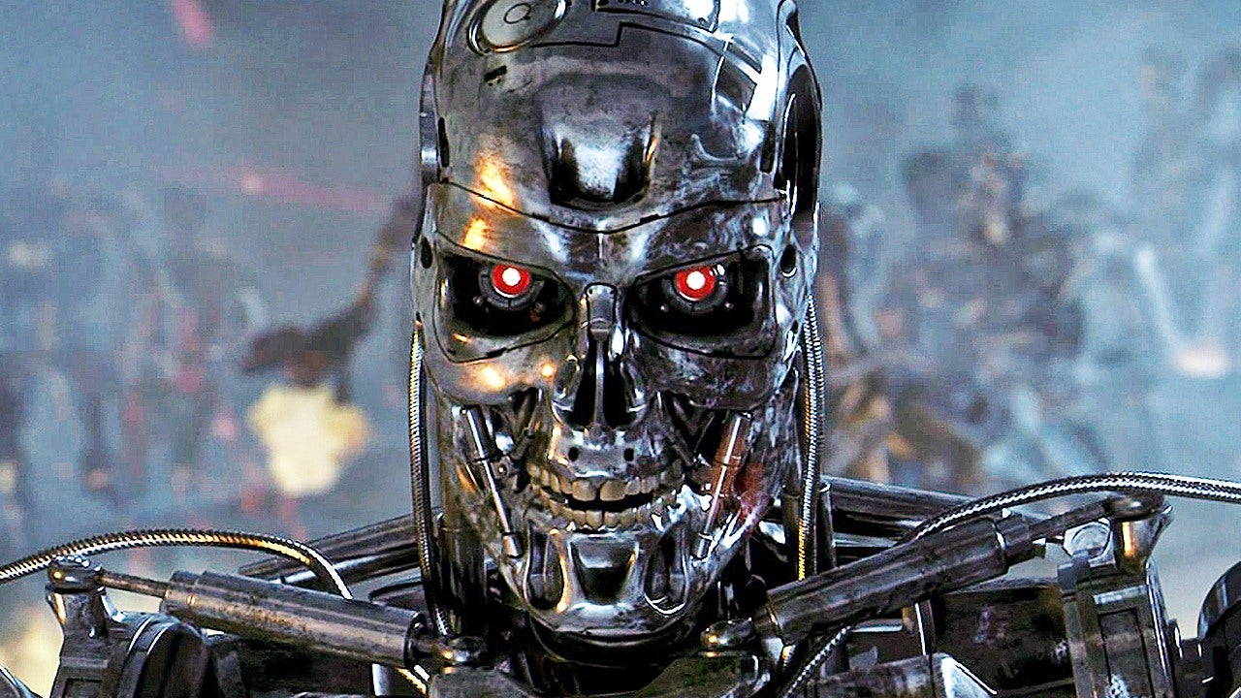

ECBD
$$≈$$
Prat-Carrabin and Woodford (2022)

Slide 30
ECBD
It looks like people are adapting their priors to the context, not just using stable naturalistic priors.
$$≈$$
Prat-Carrabin and Woodford (2022)

Slide 31
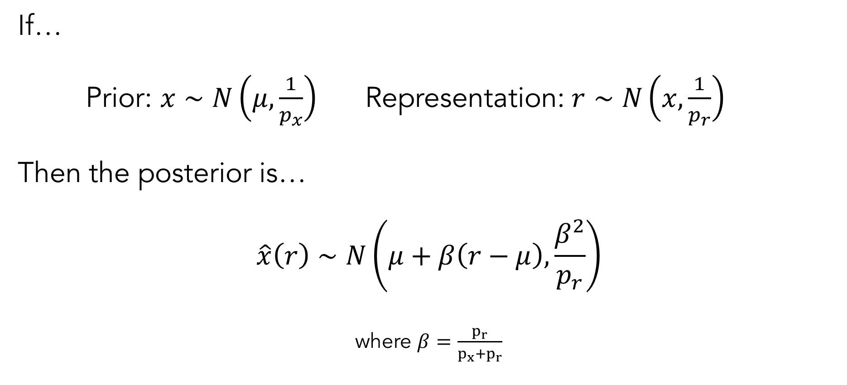
ECBD: (Over)simplified Bayesian decoding
If…
Prior: $x∼N\left(μ,\frac{1}{p_{x}}\right)$ Representation: $r∼N\left(x,\frac{1}{p_{r}}\right)$
Then the posterior is…
$$\hat{x}\left(r\right)∼N\left(μ+β\left(r−μ\right),\frac{β^{2}}{p_{r}}\right)$$
where $β=\frac{p_{r}}{p_{x}+p_{r}}$
see Woodford (2020) for detailed explanation

Slide 32
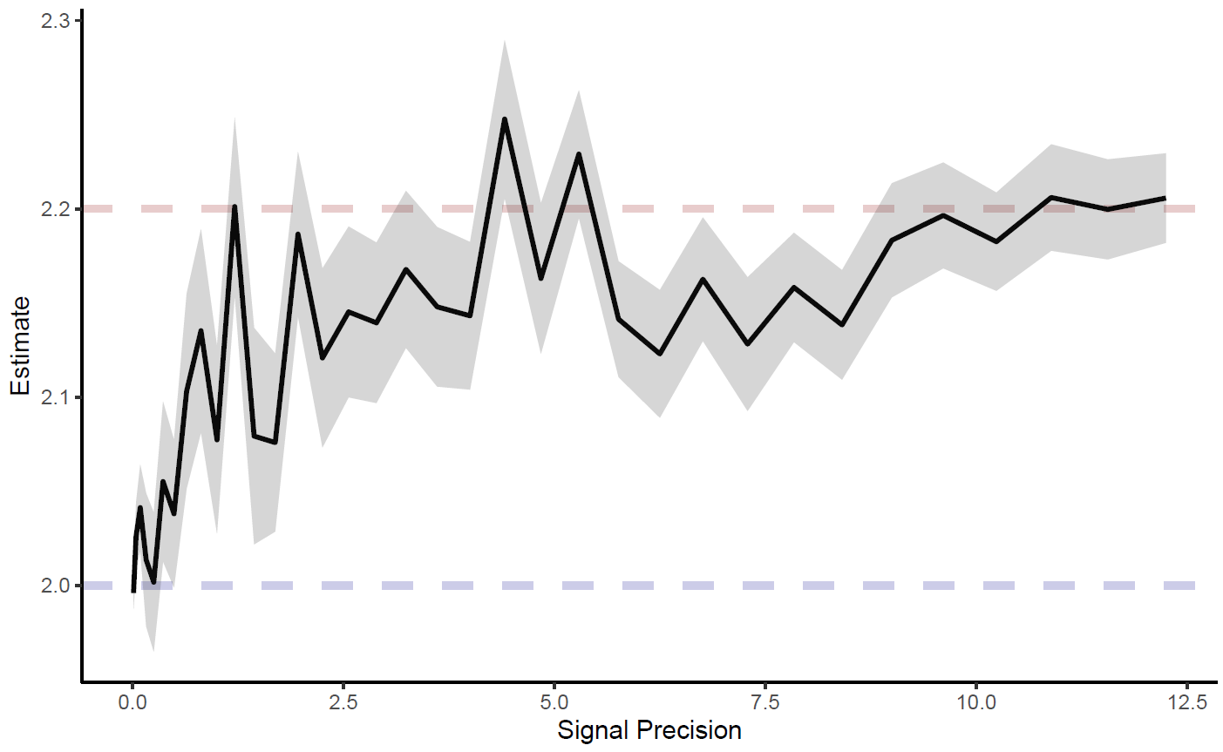
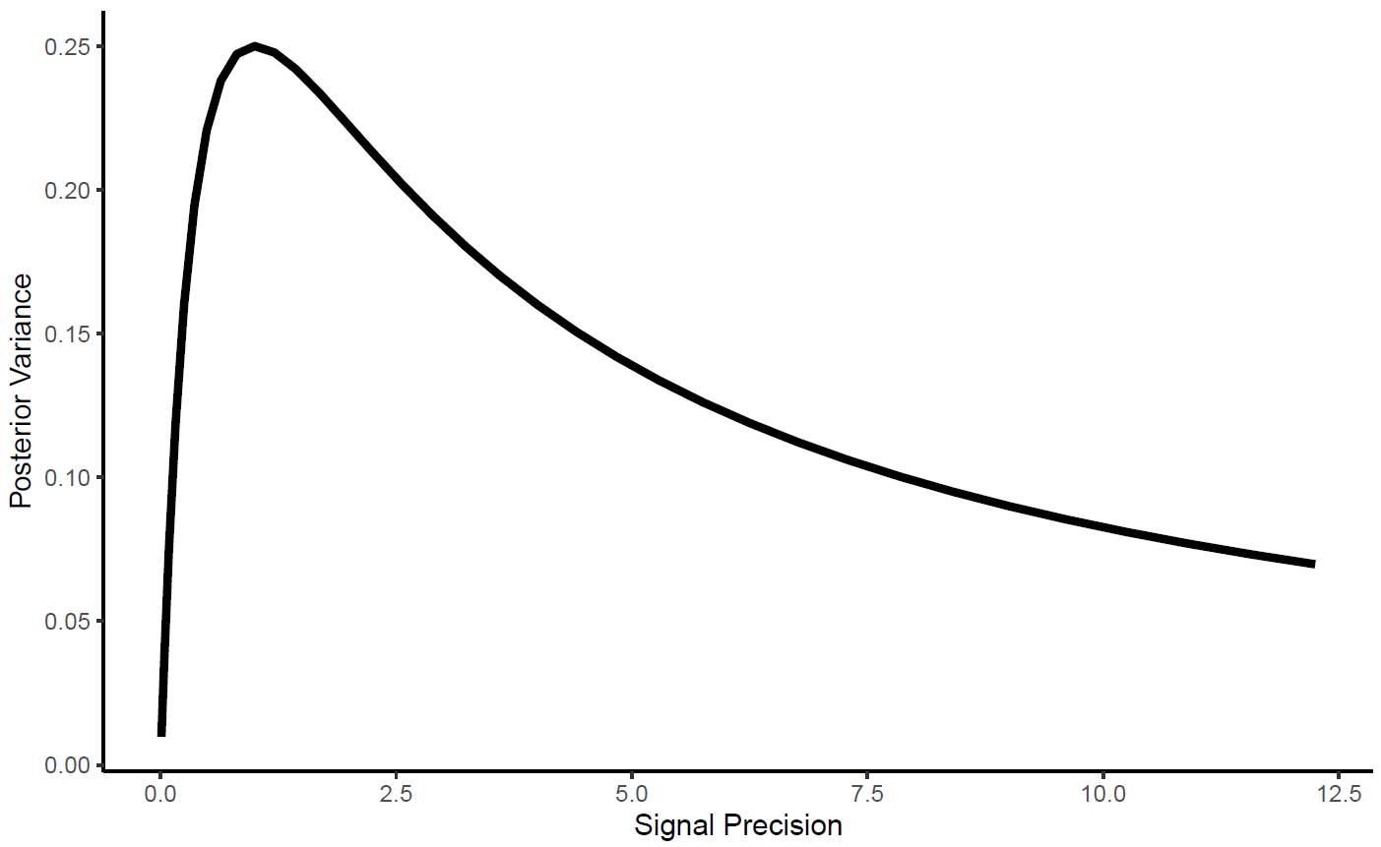
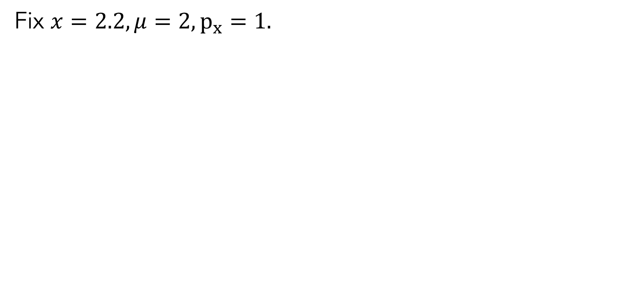
Simple ECBD
Fix $x=2.2, μ=2,p_{x}=1.$

Slide 33
Simple ECBD
Fix $x=2.2, μ=2,p_{x}=1.$
Duration of stimulus presentation (arbitrary)
Duration of stimulus presentation (arbitrary)

Slide 34
ECBD vs. Stable naturalistic priors

Slide 35
ECBD vs. Stable naturalistic priors
So which is it?

Slide 36


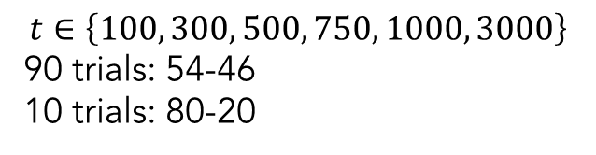
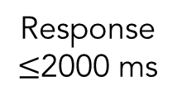
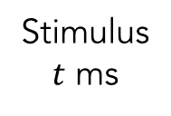
Task
100 trials
100 trials
100 trials
100 trials
B
R
B
R
+
Fixation
1500 ms
Stimulus
$t$ ms
Mask
100 ms
Response
$≤$2000 ms
$$t∈\left\{100, 300, 500, 750, 1000, 3000\right\}$$
90 trials: 54-46
10 trials: 80-20

Slide 37
Precommitment to high quality data
Drop if…
Accuracy on “sanity check” trials is <90%.

Slide 38
Results

Slide 39
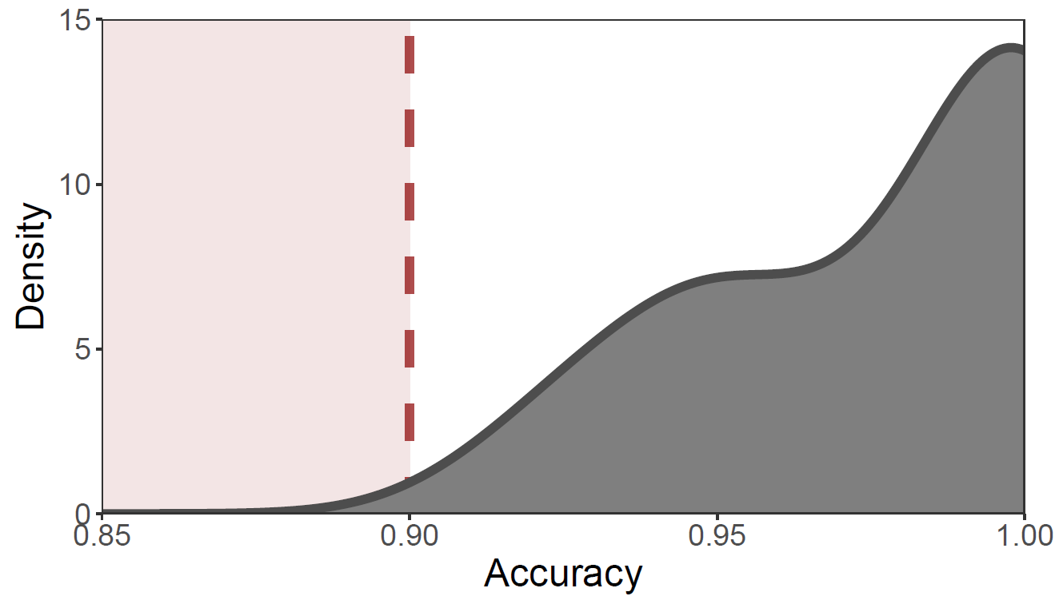
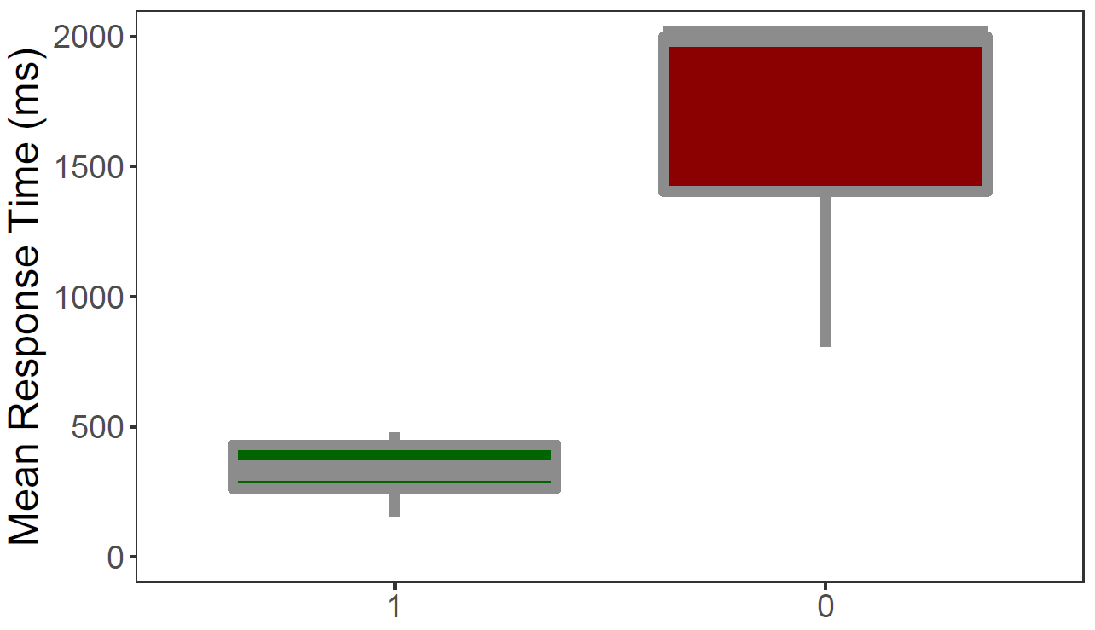
Quality check
Dropped 1 out of 10 total subjects.

Slide 40
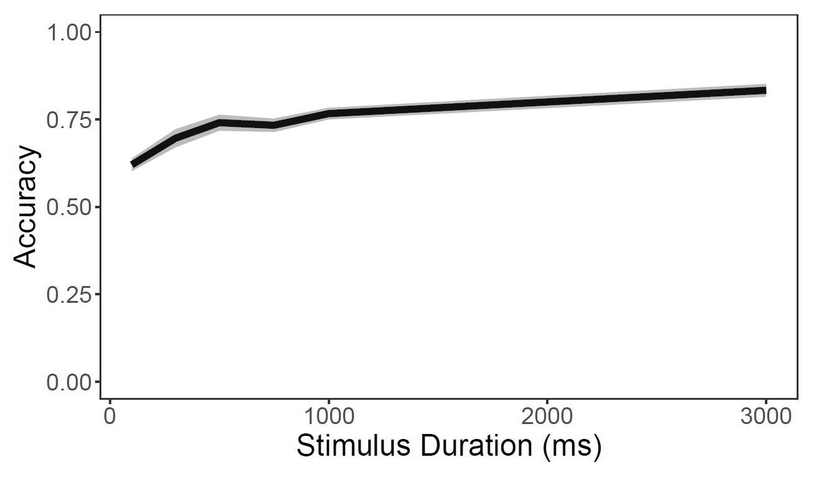
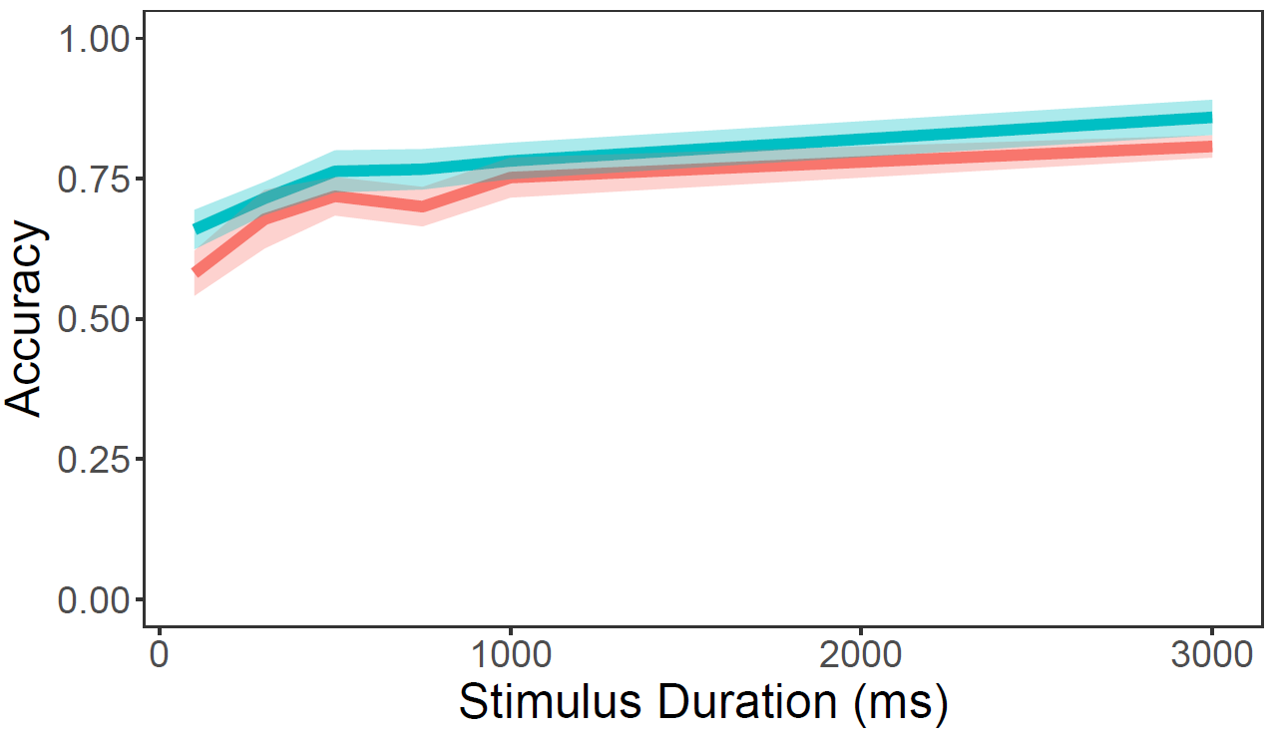
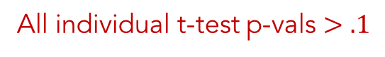
Basic psychometrics
All individual t-test p-vals $>.1$

Slide 41
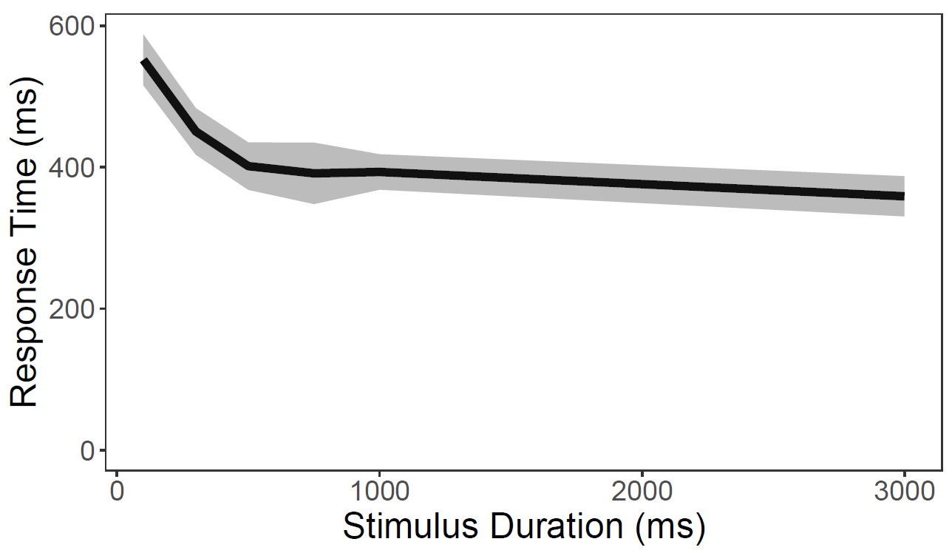
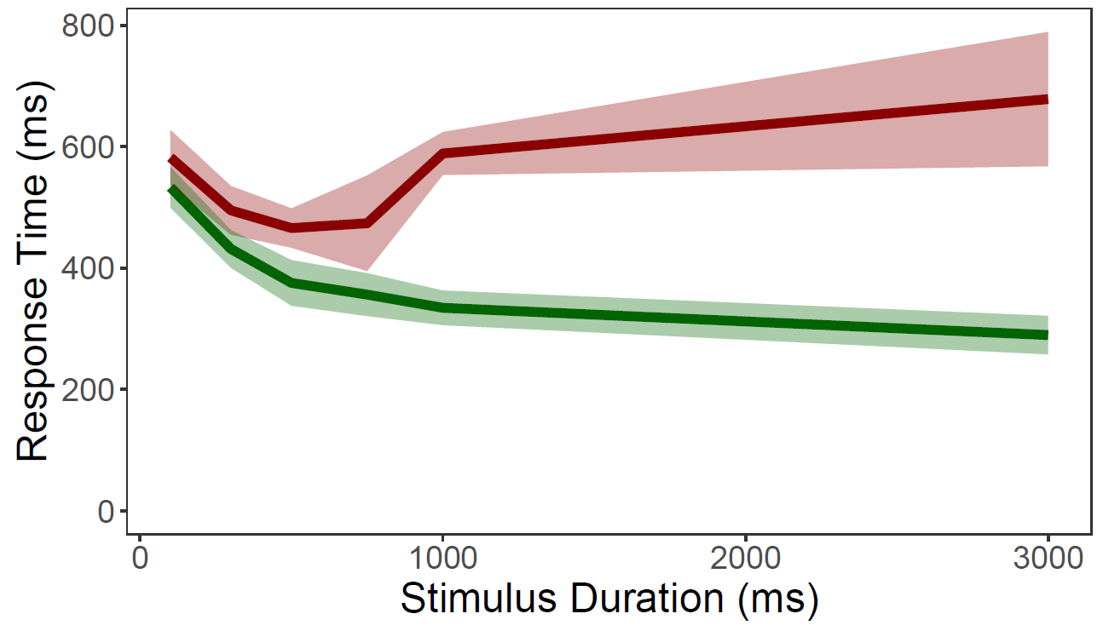
Response time

Slide 42


Effects of signal precision on estimates

Slide 43


Quick note (**TAKE THIS OUT FOR ACTUAL TALKS)

Slide 44


Quick note (**TAKE THIS OUT FOR ACTUAL TALKS)

Slide 45
Take-aways from pilot study
We should be focused on looking at average variance over stimulus duration as our test between competing classes of models, not average estimate.
We should be focusing on shorter stimulus durations, perhaps based on the times from CP (2020) (40, 80, 160, 320, 640, 1280 ms).
How can we check if 54-46 dot splits are a reasonable amount of difficulty? Average estimates do look like they’re properly separating in stimulus duration.

Slide 46
Why does any of this matter?

Slide 47

Range normalization for value neurons
Padoa-Schioppa (2009)

Slide 48



Risk aversion results from perceptual bias
Khaw, Li, and Woodford (2021)
Frydman and Jin (2022)

Slide 49


Under- and over-reaction in probabilistic inference
Prat-Carrabin and Woodford (2022, wp)

Slide 50

Non-linear weighting of numbers in an average
Prat-Carrabin and Woodford (2022, Nat Hum Behav)

Slide 51


Choice variability in in value-based choice
Polania, Woodford, and Ruff (2019)

